Slide 1
Sequential Logic, Registers, and Clocking
CS 0447
Jarrett Billingsley

Slide 2
Class announcements
break was nice

Slide 3
Combinational Logic Or "combinatorial," both are used

Slide 4
Smooshing bits together to get other bits
all the logic we've talked about so far is combinational logic.
you give it some combination of inputs, and you get an output.
+
gates, muxes, adders… these are all combinational.
for combinational logic, the outputs only depend on the current inputs.
Notes:
- they're like a mathematical function. they just compute something and give an answer.
- for each combination of inputs, there is exactly one possible output. 3 + 4 is always 7.

Slide 5
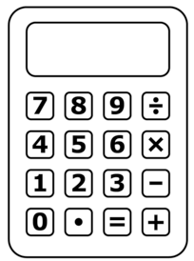
Calculators and computers
both calculators and computers do arithmetic on bits.
but what can't this calculator do that computers can?
it can't do things automatically.
that is, it can't follow sequences of steps.
how do you do a sequence of steps with combinational logic?
Notes:
- programmable calculators are just tiny computers. that's why I have to keep saying "four-function calculator."

Slide 6
You, uh, can't.
if you put a certain input into a combinational circuit…
the output will never change.
so you can't get a "sequence" of things coming out.
well, the output changes when we change the inputs.
and when signals move through it (due to propagation delay).
remember the ripple carry adder?
but that's a bad thing, right? we got strange, incorrect answers for a while until it "settled" on the final answer.
surely we couldn't… use that weirdness for something useful.

Slide 7
Using that weirdness for something useful

Slide 8
The RS Latch (or SR latch)
here's a confusing circuit.
R
Q
A NOR B = ¬(A $∨$ B)
what's the logic formula for Q?
Q = ¬(R ∨ ¬(S ∨ ¬(R ∨ ¬(S ∨ ¬(R …
S
NOR
this doesn't make sense from a combinational viewpoint. how can a gate's input depend on its own output?
A | B | Y
0 | 0 | 1
0 | 1 | 0
1 | 0 | 0
1 | 1 | 0
well, let's build it in Logisim. what's the worst that could happen, right?
(see RS_latch.circ)
Notes:
- we tend to use Q as the output of sequential circuits and Y for combinational (at least, most of the time… I’ve seen exceptions)

Slide 9
Whaaaat is going on here?
when you build it, it starts off looking angry, but…
poking R or S makes it "settle" into one state or another.
and you can switch between states, too.
it remembers.
this is one kind of memory: a circuit that remembers information.
and memory is the basis of sequential circuits.
Notes:
- this is just one kind though. there are many

Slide 10
How does it work? (animated)
because of propagation delay.
NOR
R
A | B | Y
0 | 0 | 1
0 | 1 | 0
1 | 0 | 0
1 | 1 | 0
Q
we say this circuit is bistable - it has two (bi) states where its output is stable (steady).
S
it's like a light switch: you can't really put it in the middle.
Notes:
- each gate is keeping the other gate stuck at a certain value
- like a light switch, it has two "low-energy" states and a "hill" between them that takes some energy to cross

Slide 11
But it can break… (animated)
if we input 1 for both R and S…
that's stable. but the problem is when we input 0 on both now
NOR
A | B | Y
0 | 0 | 1
0 | 1 | 0
1 | 0 | 0
1 | 1 | 0
R
which input went to 0 first?
Q
if R went to 0 first, then Q = 1
if S went to 0 first, then Q = 0
S
if they both went to 0 at the exact same time, it will oscillate (flip back and forth)!
Notes:
- oscillation is a real problem, but due to unavoidable imperfections in real life, the oscillation is self-damping and will stop after a short time
- but what state it settles into after it stops is still completely unpredictable. it’s like a coin flip.
if you’re looking at this and going “surely we couldn’t… use that oscillation for something useful” then yes. yes you can. but it’s usually done differently to produce an oscillator, a circuit that produces a repeating pattern of 0, 1, 0, 1, 0, 1… like a clock.
HEY THAT’S A FEW SLIDES FROM NOW!

Slide 12
So how do we fix it?
wellllllll uhhhhhhhhhhhhhhhh we actually can't, not 100% 💦
but we can reduce the chance of it happening so much that we don't really have to worry about it
anyway, let me wave my hands and present to you: the flip flop.
this is made up of a couple RS latches and some other gates.
data in
D
Q
data out
en
???
it stores a single bit, but in a more robust, non-breaky way, where you can’t give it invalid inputs.
???
oh boy, question marks! that means we get to learn more stuff!
Notes:
- see D_latch.circ for an intermediate step (an RS latch with some stuff on it), and D_flipflop.circ for the flip flop itself (two chained D latches).

Slide 13
Time

Slide 14
Keep your eye on the prize
sequential circuits can perform sequences of operations.
which means those things happen over time.
consider a CPU.
lw t0, x
add s0, s0, t0
sw s0, x2
the instructions happen one after another. but how? who says "it's time to run the next instruction?"
we need something to keep track of time… like… I dunno…
a clock?
Notes:
- TICK TOCK

Slide 15
Tick tock
the clock signal says when we move onto "the next step."
it keeps all the sequential circuits in sync. (combinational circuits don't need or use it.)
it switches between 0 and 1 in a steady rhythm.
rising edge
falling edge
1
0
time
clock edges are when it changes between 0 and 1. we'll use rising edges for this class.
a clock cycle is the time from e.g. one rising edge to the next.
Notes:
- yeah, this is where an oscillator circuit would come in handy! but preferably one that goes forever, and ticks at a predictable rate.

Slide 16
All our hearts beating as one
no matter how many memory components there are in your circuit…
you will always have exactly one clock component.
Wiring > Clock makes it:
Simulate > Ticks Enabled makes it tick continuously.
you can also Ctrl/Cmd+T to make it tick once.
now you can hook this up to every component which needs it. this is a great use for tunnels!
Notes:
- and you can change how fast those automatic ticks happen in the Simulate menu too.

Slide 17
Great! So what? (animated)
how does the clock actually make things "take a step?"
D
Q
for a rising edge-triggered flip-flop…
a rising edge of the clock makes it "take a snapshot" of whatever is on its input, and remember it.
this triangular input on the flip-flop is where the clock connects.
now!!
now the input can change but the flip flop remembers what it saw at the last rising clock edge, until the next clock edge comes.

Slide 18
The clock input symbol
whenever you see this little triangle…
this is the clock signal input.
that means this component remembers things.
often I won't draw the clock signal wire on the slides, but always assume it's hooked up. (it wouldn't work otherwise.)

Slide 19
Registers

Slide 20
A 1-bit register
let's make a 1-bit register:
D
Q
en
done.
a flip-flop is a 1-bit register.
well, if a 32-bit adder is 32 1-bit adders…
what do you think a multi-bit register is?

Slide 21
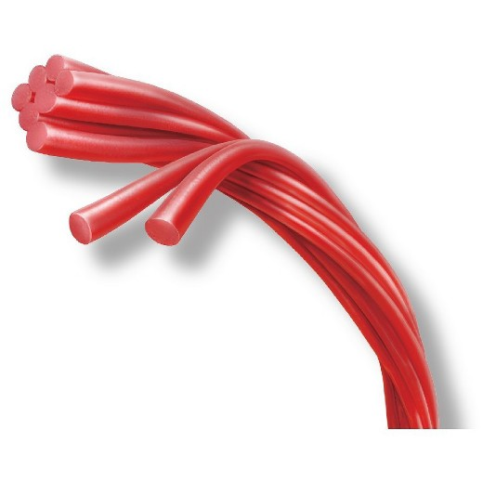
Tangent: Pull n peel
splitters are how we convert between bundles and individual wires.
a splitter lets us split up wire bundles…
…or bundle wires back together.
4
4
we can do fun stuff in the middle.

Slide 22
An n-bit register
an n bit register is n flip-flops next to each other
each flip-flop holds 1 bit of the 4-bit value
D
Q
write enable
en
D
Q
4
en
4
D
Q
en
now we have a 4-bit register!
(see register_4bit.circ)
D
Q
en
wait what is this "en" thing

Slide 23
Write Enables

Slide 24
One at a time, now
let's assume that each MIPS instruction takes one clock cycle.*
in the following code, what register changes on each step?
lw t0, x
add s0, s0, t0
sw s0, y
t0 changes.
s0 changes.
none change.
we have 32 registers, but on each step, at most one register changes.
so we have to have some way to enable and disable registers. a way to say "don't write on this clock cycle."
Notes:
* this is going to be true for the simplistic kind of CPU we'll build and talk about over the next few weeks, but it's not true in general.

Slide 25
Take a picture, but only when I say so (animated)
a write enable is like a door on the input of the register.
D
Q
0
en
huh…?
when the write enable is 0, it ignores the clock, and the value never changes.
now!!
the only way to change its value is when the write enable is 1 and the clock has a rising edge.

Slide 26
The bigger picture
a write enable chooses if we change a register's value on each cycle.
CLK
WE
REG
time
because of that, a register with a write enable can remember a value across multiple clock cycles, instead of just "until the next cycle."
this is really important when you have a complicated circuit with lots of registers (like uhhhhhh a CPU!)
Notes:
- this is a real kind of diagram; it comes up a lot in logic analysis and simulation. software like gtkwave can show these "traces."
- see how REG shows Xs when the value is changing, and a solid pair of lines when the value is stable (remembered/stored).

Slide 27
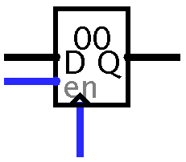
Logisim's register component
if you place a Memory > Register, you get this:
the stored value, in hex
data goes in here
data comes out here
(always outputs the stored value)
write enable – if not
connected, it's always enabled!
clock!
don't get confused: the
"en" is for the left input, not the clock on the bottom
Notes:
- if you make a register with a data size of 1, it's basically a flip-flop.

Slide 28
OK but what can we do with a register?

Slide 29
Blinky blinky (animated)
what if we had a register that stored 1 bit (a flip-flop)
and we had a NOT gate hooked up in a loop like this…
and we had a light hooked up to the register output…
D
Q
0
1
and we tick the clock? (assuming the register is always enabled)
we get a blinky. it's the "hello world" of hardware.
Notes:
- in reality, the clock is ticking at many MHz or GHz, so you have to use a counter to count millions of cycles and turn the light on when the top bit is a 1, but the idea is the same OKAY

Slide 30
Wait, why does this work? (animated)
why doesn't this circuit oscillate when the register changes value?
again, we have propagation delay to thank for this.
when the input is a 1 and the clock ticks, the register stores the value, but…
1
0
0
1
D
Q
…there is a delay before the register starts outputting its new value…
0
1
…and then another delay for the NOT to compute its output.
by the time the 0 makes it to the input, the register has "closed the door."
it won't accept any new values until the next rising clock edge.
Notes:
- it's like writing "x = x + 1" in an HLL. the "x + 1" happens first, and then the assignment to x happens.

Slide 31
The circle of life
let's generalize that pattern of combinational and sequential circuits.
combinational circuits let us do any computation…
…sequential circuits let us remember the results…
74
…and connecting them in a loop lets us do multi-step operations.
these start to look a bit like programs…
Notes:
- this circuit pattern will show up over and over and over for the rest of the term. get used to it!

Slide 32
Let's make a Thing!
first, let's look at simple_counter.circ.
it's a simple counter. HUH.
now, let's modify it to make it do something a little more interesting.
maybe it only counts when the user holds a button.
maybe it only counts when the value is less than 10.
maybe it can count up or down, depending on some input.

